Slide 1
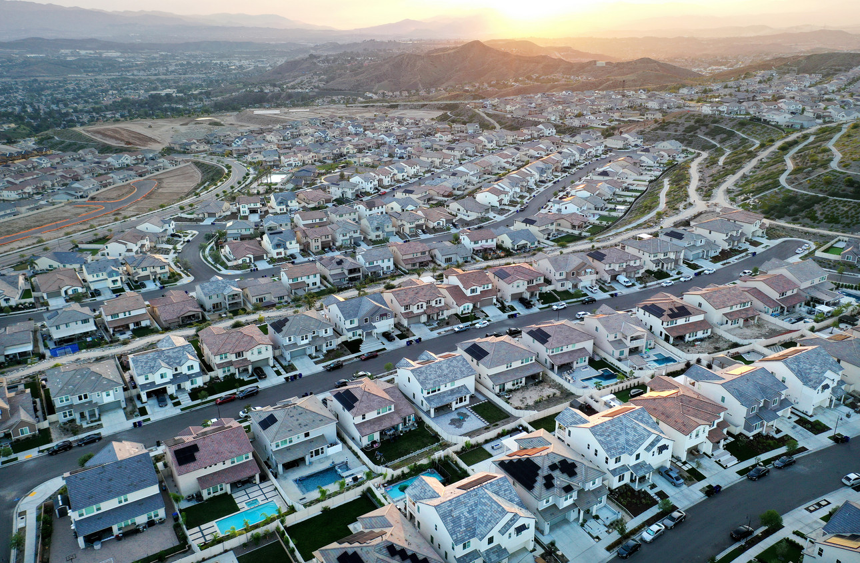
US Housing Affordability Analysis
Executive Presentation

Slide 2
1
US median income has increased significantly over the past 5 decades, but…
Executive Summary
…US home prices have consistently risen faster than US incomes, making home ownership more difficult to obtain
2
3
Americans must dedicate ~2x more of their annual income to home ownership than prior generations

Slide 3
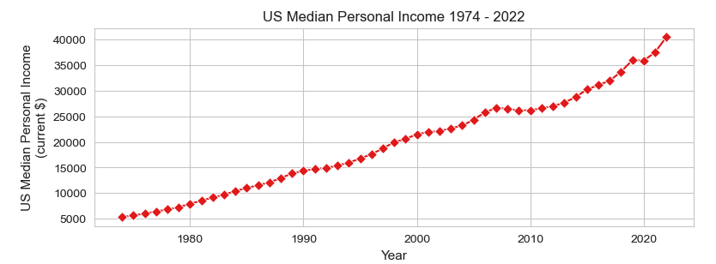
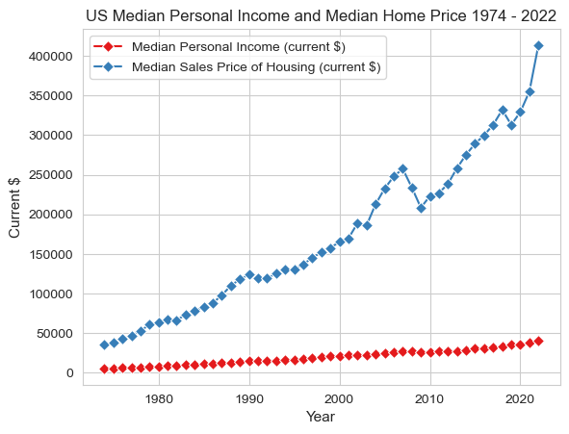
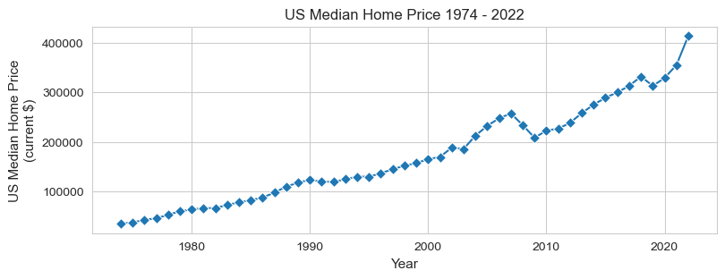
US median income has risen significantly since 1974, but at a much slower rate than US median home prices
US median income has grown at a CAGR of 4.31% since 1974…
Over time this difference in growth rates has led to an increasing gap between median home prices and median annual incomes
CAGR = 5.27%
CAGR = 4.31%
…while US median home prices have grown at a CAGR of 5.27%
Despite significant increases in personal income over the last 5 decades, American’s income has failed to keep pace with increasing home prices.

Slide 4
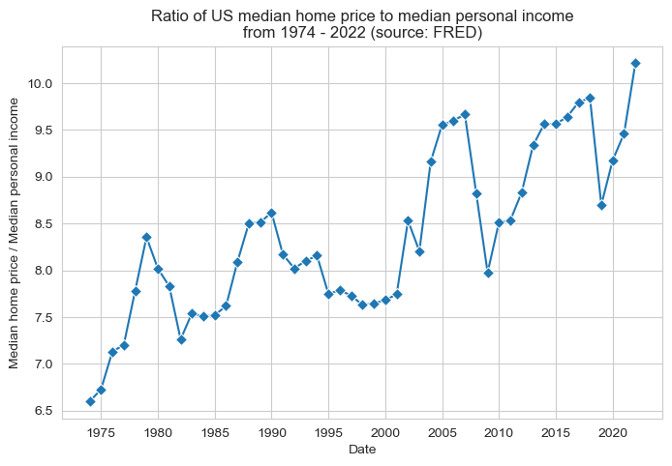
Home ownership has become increasingly unaffordable since 1974
The cost of US housing has outpaced income growth by a wide margin, placing home ownership increasingly out of reach for the average American. Americans must dedicate ~2x more of their annual income to their home purchase than previous generations
In 2022 median US house costs > 10x the median US annual income
- nearly double the portion of US median annual income in 1974
The median US house price was ~10.2x the US median annual income in 2022
~10.2x
1974 – 2022: the cost of US housing as a percentage of personal income has grown by ~ 1% per year
The median US house price was ~6.6x the US median annual income in 1974
~6.6x
Americans must dedicate nearly 2x the amount of their annual income to home ownership than previous generations. Home ownership is increasingly out of reach for the average American.

Slide 5
Next Steps
Home prices vary greatly by region - an analysis of home prices and income in independent metro areas may provide more insight into housing affordability
An analysis of home supply (new house builds, number of homes on market) and housing demand may provide insight into the underlying reasons behind the home price increase

